Slide 1
Multivariate Analysis
Many statistical techniques focus on just one or two variables
Multivariate analysis (MVA) techniques allow more than two variables to be analysed at once
Multiple regression is not typically included under this heading, but can be thought of as a multivariate analysis

Slide 2
Outline of Lectures
We will cover
Why MVA is useful and important
Simpson’s Paradox
Some commonly used techniques
Principal components
Cluster analysis
Correspondence analysis
Others if time permits
Market segmentation methods
An overview of MVA methods and their niches

Slide 3
Simpson’s Paradox
Example: 44% of male applicants are admitted by a university, but only 33% of female applicants
Does this mean there is unfair discrimination?
University investigates and breaks down figures for Engineering and English programmes
 | Male | Female
Accept | 35 | 20
Refuse entry | 45 | 40
Total | 80 | 60

Slide 4
Simpson’s Paradox
No relationship between sex and acceptance for either programme
So no evidence of discrimination
Why?
More females apply for the English programme, but it it hard to get into
More males applied to Engineering, which has a higher acceptance rate than English
Must look deeper than single cross-tab to find this out
Engineer-ing | Male | Female
Accept | 30 | 10
Refuse entry | 30 | 10
Total | 60 | 20
English | Male | Female
Accept | 5 | 10
Refuse entry | 15 | 30
Total | 20 | 40

Slide 5
Another Example
A study of graduates’ salaries showed negative association between economists’ starting salary and the level of the degree
i.e. PhDs earned less than Masters degree holders, who in turn earned less than those with just a Bachelor’s degree
Why?
The data was split into three employment sectors
Teaching, government and private industry
Each sector showed a positive relationship
Employer type was confounded with degree level

Slide 7
Simpson’s Paradox
In each of these examples, the bivariate analysis (cross-tabulation or correlation) gave misleading results
Introducing another variable gave a better understanding of the data
It even reversed the initial conclusions

Slide 8
Many Variables
Commonly have many relevant variables in market research surveys
E.g. one not atypical survey had ~2000 variables
Typically researchers pore over many crosstabs
However it can be difficult to make sense of these, and the crosstabs may be misleading
MVA can help summarise the data
E.g. factor analysis and segmentation based on agreement ratings on 20 attitude statements
MVA can also reduce the chance of obtaining spurious results

Slide 9
Multivariate Analysis Methods
Two general types of MVA technique
Analysis of dependence
Where one (or more) variables are dependent variables, to be explained or predicted by others
E.g. Multiple regression, PLS, MDA
Analysis of interdependence
No variables thought of as “dependent”
Look at the relationships among variables, objects or cases
E.g. cluster analysis, factor analysis

Slide 10
Principal Components
Identify underlying dimensions or principal components of a distribution
Helps understand the joint or common variation among a set of variables
Probably the most commonly used method of deriving “factors” in factor analysis (before rotation)

Slide 11
Principal Components
The first principal component is identified as the vector (or equivalently the linear combination of variables) on which the most data variation can be projected
The 2nd principal component is a vector perpendicular to the first, chosen so that it contains as much of the remaining variation as possible
And so on for the 3rd principal component, the 4th, the 5th etc.

Slide 12
Principal Components - Examples
Ellipse, ellipsoid, sphere
Rugby ball
Pen
Frying pan
Banana
CD
Book

Slide 13
Multivariate Normal Distribution
Generalisation of the univariate normal
Determined by the mean (vector) and covariance matrix
E.g. Standard bivariate normal

Slide 14
Example – Crime Rates by State
Crime Rates per 100,000 Population by State
Crime Rates per 100,000 Population by State
Obs | State | Murder | Rape | Robbery | Assault | Burglary | Larceny | Auto_Theft
1 | Alabama | 14.2 | 25.2 | 96.8 | 278.3 | 1135.5 | 1881.9 | 280.7
2 | Alaska | 10.8 | 51.6 | 96.8 | 284.0 | 1331.7 | 3369.8 | 753.3
3 | Arizona | 9.5 | 34.2 | 138.2 | 312.3 | 2346.1 | 4467.4 | 439.5
4 | Arkansas | 8.8 | 27.6 | 83.2 | 203.4 | 972.6 | 1862.1 | 183.4
5 | California | 11.5 | 49.4 | 287.0 | 358.0 | 2139.4 | 3499.8 | 663.5
… | … | ... | ... | ... | ... | ... | ... | ...
The PRINCOMP Procedure
Observations | 50
Variables | 7
Simple Statistics
 | Murder | Rape | Robbery | Assault | Burglary | Larceny | Auto_Theft
Mean | 7.444000000 | 25.73400000 | 124.0920000 | 211.3000000 | 1291.904000 | 2671.288000 | 377.5260000
StD | 3.866768941 | 10.75962995 | 88.3485672 | 100.2530492 | 432.455711 | 725.908707 | 193.3944175

Slide 15
Correlation Matrix
 | Murder | Rape | Robbery | Assault | Burglary | Larceny | Auto_Theft
Murder | 1.0000 | 0.6012 | 0.4837 | 0.6486 | 0.3858 | 0.1019 | 0.0688
Rape | 0.6012 | 1.0000 | 0.5919 | 0.7403 | 0.7121 | 0.6140 | 0.3489
Robbery | 0.4837 | 0.5919 | 1.0000 | 0.5571 | 0.6372 | 0.4467 | 0.5907
Assault | 0.6486 | 0.7403 | 0.5571 | 1.0000 | 0.6229 | 0.4044 | 0.2758
Burglary | 0.3858 | 0.7121 | 0.6372 | 0.6229 | 1.0000 | 0.7921 | 0.5580
Larceny | 0.1019 | 0.6140 | 0.4467 | 0.4044 | 0.7921 | 1.0000 | 0.4442
Auto_Theft | 0.0688 | 0.3489 | 0.5907 | 0.2758 | 0.5580 | 0.4442 | 1.0000
Eigenvalues of the Correlation Matrix
 | Eigenvalue | Difference | Proportion | Cumulative
1 | 4.11495951 | 2.87623768 | 0.5879 | 0.5879
2 | 1.23872183 | 0.51290521 | 0.1770 | 0.7648
3 | 0.72581663 | 0.40938458 | 0.1037 | 0.8685
4 | 0.31643205 | 0.05845759 | 0.0452 | 0.9137
5 | 0.25797446 | 0.03593499 | 0.0369 | 0.9506
6 | 0.22203947 | 0.09798342 | 0.0317 | 0.9823
7 | 0.12405606 |  | 0.0177 | 1.0000

Slide 16
Eigenvectors
 | Prin1 | Prin2 | Prin3 | Prin4 | Prin5 | Prin6 | Prin7
Murder | 0.300279 | -.629174 | 0.178245 | -.232114 | 0.538123 | 0.259117 | 0.267593
Rape | 0.431759 | -.169435 | -.244198 | 0.062216 | 0.188471 | -.773271 | -.296485
Robbery | 0.396875 | 0.042247 | 0.495861 | -.557989 | -.519977 | -.114385 | -.003903
Assault | 0.396652 | -.343528 | -.069510 | 0.629804 | -.506651 | 0.172363 | 0.191745
Burglary | 0.440157 | 0.203341 | -.209895 | -.057555 | 0.101033 | 0.535987 | -.648117
Larceny | 0.357360 | 0.402319 | -.539231 | -.234890 | 0.030099 | 0.039406 | 0.601690
Auto_Theft | 0.295177 | 0.502421 | 0.568384 | 0.419238 | 0.369753 | -.057298 | 0.147046
2-3 components explain 76%-87% of the variance
First principal component has uniform variable weights, so is a general crime level indicator
Second principal component appears to contrast violent versus property crimes
Third component is harder to interpret

Slide 17
Cluster Analysis
Techniques for identifying separate groups of similar cases
Similarity of cases is either specified directly in a distance matrix, or defined in terms of some distance function
Also used to summarise data by defining segments of similar cases in the data
This use of cluster analysis is known as “dissection”

Slide 18
Clustering Techniques
Two main types of cluster analysis methods
Hierarchical cluster analysis
Each cluster (starting with the whole dataset) is divided into two, then divided again, and so on
Iterative methods
k-means clustering (PROC FASTCLUS)
Analogous non-parametric density estimation method
Also other methods
Overlapping clusters
Fuzzy clusters

Slide 19
Applications
Market segmentation is usually conducted using some form of cluster analysis to divide people into segments
Other methods such as latent class models or archetypal analysis are sometimes used instead
It is also possible to cluster other items such as products/SKUs, image attributes, brands

Slide 20
Tandem Segmentation
One general method is to conduct a factor analysis, followed by a cluster analysis
This approach has been criticised for losing information and not yielding as much discrimination as cluster analysis alone
However it can make it easier to design the distance function, and to interpret the results

Slide 21
Tandem k-means Example
proc factor data=datafile n=6 rotate=varimax round reorder flag=.54 scree out=scores;
var reasons1-reasons15 usage1-usage10;
run;
proc fastclus data=scores maxc=4 seed=109162319 maxiter=50;
var factor1-factor6;
run;
Have used the default unweighted Euclidean distance function, which is not sensible in every context
Also note that k-means results depend on the initial cluster centroids (determined here by the seed)
Typically k-means is very prone to local maxima
Run at least 20 times to ensure reasonable maximum

Slide 22
Selected Outputs
19th run of 5 segments
Cluster Summary
Maximum Distance
RMS Std from Seed Nearest Distance Between
Cluster Frequency Deviation to Observation Cluster Cluster Centroids
ƒƒƒƒƒƒƒƒƒƒƒƒƒƒƒƒƒƒƒƒƒƒƒƒƒƒƒƒƒƒƒƒƒƒƒƒƒƒƒƒƒƒƒƒƒƒƒƒƒƒƒƒƒƒƒƒƒƒƒƒƒƒƒƒƒƒƒƒƒƒƒƒƒƒƒƒƒƒƒƒƒƒƒƒƒƒ
1 433 0.9010 4.5524 4 2.0325
2 471 0.8487 4.5902 4 1.8959
3 505 0.9080 5.3159 4 2.0486
4 870 0.6982 4.2724 2 1.8959
5 433 0.9300 4.9425 4 2.0308

Slide 23
Selected Outputs
19th run of 5 segments
FASTCLUS Procedure: Replace=RANDOM Radius=0 Maxclusters=5 Maxiter=100 Converge=0.02
Statistics for Variables
Variable Total STD Within STD R-Squared RSQ/(1-RSQ)
ƒƒƒƒƒƒƒƒƒƒƒƒƒƒƒƒƒƒƒƒƒƒƒƒƒƒƒƒƒƒƒƒƒƒƒƒƒƒƒƒƒƒƒƒƒƒƒƒƒƒƒƒƒƒƒƒƒƒƒƒƒƒƒƒƒƒƒƒƒƒƒƒƒƒ
FACTOR1 1.000000 0.788183 0.379684 0.612082
FACTOR2 1.000000 0.893187 0.203395 0.255327
FACTOR3 1.000000 0.809710 0.345337 0.527503
FACTOR4 1.000000 0.733956 0.462104 0.859095
FACTOR5 1.000000 0.948424 0.101820 0.113363
FACTOR6 1.000000 0.838418 0.298092 0.424689
OVER-ALL 1.000000 0.838231 0.298405 0.425324
Pseudo F Statistic = 287.84
Approximate Expected Over-All R-Squared = 0.37027
Cubic Clustering Criterion = -26.135
WARNING: The two above values are invalid for correlated variables.

Slide 24
Selected Outputs
19th run of 5 segments
Cluster Means
Cluster FACTOR1 FACTOR2 FACTOR3 FACTOR4 FACTOR5 FACTOR6
ƒƒƒƒƒƒƒƒƒƒƒƒƒƒƒƒƒƒƒƒƒƒƒƒƒƒƒƒƒƒƒƒƒƒƒƒƒƒƒƒƒƒƒƒƒƒƒƒƒƒƒƒƒƒƒƒƒƒƒƒƒƒƒƒƒƒƒƒƒƒƒƒƒƒƒƒƒƒƒƒƒƒƒƒƒƒƒƒƒƒƒ
1 -0.17151 0.86945 -0.06349 0.08168 0.14407 1.17640
2 -0.96441 -0.62497 -0.02967 0.67086 -0.44314 0.05906
3 -0.41435 0.09450 0.15077 -1.34799 -0.23659 -0.35995
4 0.39794 -0.00661 0.56672 0.37168 0.39152 -0.40369
5 0.90424 -0.28657 -1.21874 0.01393 -0.17278 -0.00972
Cluster Standard Deviations
Cluster FACTOR1 FACTOR2 FACTOR3 FACTOR4 FACTOR5 FACTOR6
ƒƒƒƒƒƒƒƒƒƒƒƒƒƒƒƒƒƒƒƒƒƒƒƒƒƒƒƒƒƒƒƒƒƒƒƒƒƒƒƒƒƒƒƒƒƒƒƒƒƒƒƒƒƒƒƒƒƒƒƒƒƒƒƒƒƒƒƒƒƒƒƒƒƒƒƒƒƒƒƒƒƒƒƒƒƒƒƒƒƒƒ
1 0.95604 0.79061 0.95515 0.81100 1.08437 0.76555
2 0.79216 0.97414 0.88440 0.71032 0.88449 0.82223
3 0.89084 0.98873 0.90514 0.74950 0.92269 0.97107
4 0.59849 0.74758 0.56576 0.58258 0.89372 0.74160
5 0.80602 1.03771 0.86331 0.91149 1.00476 0.93635

Slide 25
Cluster Analysis Options
There are several choices of how to form clusters in hierarchical cluster analysis
Single linkage
Average linkage
Density linkage
Ward’s method
Many others
Ward’s method (like k-means) tends to form equal sized, roundish clusters
Average linkage generally forms roundish clusters with equal variance
Density linkage can identify clusters of different shapes

Slide 26
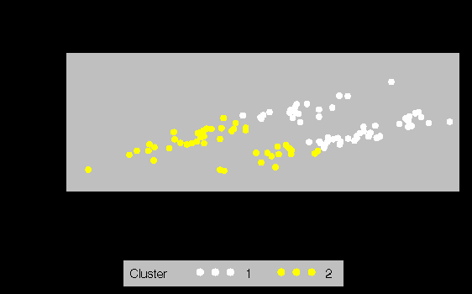
FASTCLUS

Slide 27
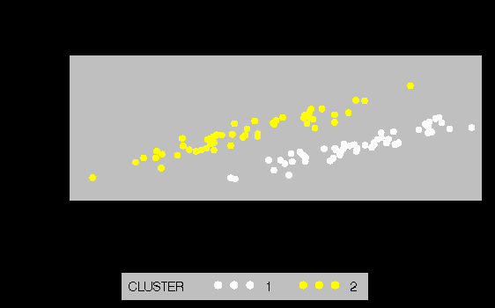
Density Linkage

Slide 28
Cluster Analysis Issues
Distance definition
Weighted Euclidean distance often works well, if weights are chosen intelligently
Cluster shape
Shape of clusters found is determined by method, so choose method appropriately
Hierarchical methods usually take more computation time than k-means
However multiple runs are more important for k-means, since it can be badly affected by local minima
Adjusting for response styles can also be worthwhile
Some people give more positive responses overall than others
Clusters may simply reflect these response styles unless this is adjusted for, e.g. by standardising responses across attributes for each respondent

Slide 29
MVA - FASTCLUS
PROC FASTCLUS in SAS tries to minimise the root mean square difference between the data points and their corresponding cluster means
Iterates until convergence is reached on this criterion
However it often reaches a local minimum
Can be useful to run many times with different seeds and choose the best set of clusters based on this RMS criterion
See http://www.clustan.com/k-means_critique.html for more k-means issues

Slide 30
Iteration History from FASTCLUS
Relative Change in Cluster Seeds
Iteration Criterion 1 2 3 4 5
ƒƒƒƒƒƒƒƒƒƒƒƒƒƒƒƒƒƒƒƒƒƒƒƒƒƒƒƒƒƒƒƒƒƒƒƒƒƒƒƒƒƒƒƒƒƒƒƒƒƒƒƒƒƒƒƒƒƒƒƒƒƒƒƒƒƒƒƒƒƒƒƒƒƒƒƒƒƒƒƒƒƒ
1 0.9645 1.0436 0.7366 0.6440 0.6343 0.5666
2 0.8596 0.3549 0.1727 0.1227 0.1246 0.0731
3 0.8499 0.2091 0.1047 0.1047 0.0656 0.0584
4 0.8454 0.1534 0.0701 0.0785 0.0276 0.0439
5 0.8430 0.1153 0.0640 0.0727 0.0331 0.0276
6 0.8414 0.0878 0.0613 0.0488 0.0253 0.0327
7 0.8402 0.0840 0.0547 0.0522 0.0249 0.0340
8 0.8392 0.0657 0.0396 0.0440 0.0188 0.0286
9 0.8386 0.0429 0.0267 0.0324 0.0149 0.0223
10 0.8383 0.0197 0.0139 0.0170 0.0119 0.0173
Convergence criterion is satisfied.
Criterion Based on Final Seeds = 0.83824

Slide 31
Results from Different Initial Seeds
19th run of 5 segments
Cluster Means
Cluster FACTOR1 FACTOR2 FACTOR3 FACTOR4 FACTOR5 FACTOR6
ƒƒƒƒƒƒƒƒƒƒƒƒƒƒƒƒƒƒƒƒƒƒƒƒƒƒƒƒƒƒƒƒƒƒƒƒƒƒƒƒƒƒƒƒƒƒƒƒƒƒƒƒƒƒƒƒƒƒƒƒƒƒƒƒƒƒƒƒƒƒƒƒƒƒƒƒƒƒƒƒƒƒƒƒƒƒƒƒƒƒƒ
1 -0.17151 0.86945 -0.06349 0.08168 0.14407 1.17640
2 -0.96441 -0.62497 -0.02967 0.67086 -0.44314 0.05906
3 -0.41435 0.09450 0.15077 -1.34799 -0.23659 -0.35995
4 0.39794 -0.00661 0.56672 0.37168 0.39152 -0.40369
5 0.90424 -0.28657 -1.21874 0.01393 -0.17278 -0.00972
20th run of 5 segments
Cluster Means
Cluster FACTOR1 FACTOR2 FACTOR3 FACTOR4 FACTOR5 FACTOR6
ƒƒƒƒƒƒƒƒƒƒƒƒƒƒƒƒƒƒƒƒƒƒƒƒƒƒƒƒƒƒƒƒƒƒƒƒƒƒƒƒƒƒƒƒƒƒƒƒƒƒƒƒƒƒƒƒƒƒƒƒƒƒƒƒƒƒƒƒƒƒƒƒƒƒƒƒƒƒƒƒƒƒƒƒƒƒƒƒƒƒƒ
1 0.08281 -0.76563 0.48252 -0.51242 -0.55281 0.64635
2 0.39409 0.00337 0.54491 0.38299 0.64039 -0.26904
3 -0.12413 0.30691 -0.36373 -0.85776 -0.31476 -0.94927
4 0.63249 0.42335 -1.27301 0.18563 0.15973 0.77637
5 -1.20912 0.21018 -0.07423 0.75704 -0.26377 0.13729

Slide 32
Howard-Harris Approach
Provides automatic approach to choosing seeds for k-means clustering
Chooses initial seeds by fixed procedure
Takes variable with highest variance, splits the data at the mean, and calculates centroids of the resulting two groups
Applies k-means with these centroids as initial seeds
This yields a 2 cluster solution
Choose the cluster with the higher within-cluster variance
Choose the variable with the highest variance within that cluster, split the cluster as above, and repeat to give a 3 cluster solution
Repeat until have reached a set number of clusters
I believe this approach is used by the ESPRI software package (after variables are standardised by their range)

Slide 33
Another “Clustering” Method
One alternative approach to identifying clusters is to fit a finite mixture model
Assume the overall distribution is a mixture of several normal distributions
Typically this model is fit using some variant of the EM algorithm
E.g. weka.clusterers.EM method in WEKA data mining package
See WEKA tutorial for an example using Fisher’s iris data
Advantages of this method include:
Probability model allows for statistical tests
Handles missing data within model fitting process
Can extend this approach to define clusters based on model parameters, e.g. regression coefficients
Also known as latent class modeling

Slide 34
Cluster Means
=max.
=min.
 | Cluster 1 | Cluster 2 | Cluster 3 | Cluster 4
Reason 1 | 4.55 | 2.65 | 4.21 | 4.50
Reason 2 | 4.32 | 4.32 | 4.12 | 4.02
Reason 3 | 4.43 | 3.28 | 3.90 | 4.06
Reason 4 | 3.85 | 3.89 | 2.15 | 3.35
Reason 5 | 4.10 | 3.77 | 2.19 | 3.80
Reason 6 | 4.50 | 4.57 | 4.09 | 4.28
Reason 7 | 3.93 | 4.10 | 1.94 | 3.66
Reason 8 | 4.09 | 3.17 | 2.30 | 3.77
Reason 9 | 4.17 | 4.27 | 3.51 | 3.82
Reason 10 | 4.12 | 3.75 | 2.66 | 3.47
Reason 11 | 4.58 | 3.79 | 3.84 | 4.37
Reason 12 | 3.51 | 2.78 | 1.86 | 2.60
Reason 13 | 4.14 | 3.95 | 3.06 | 3.45
Reason 14 | 3.96 | 3.75 | 2.06 | 3.83
Reason 15 | 4.19 | 2.42 | 2.93 | 4.04

Slide 35
Cluster Means
=max.
=min.
 | Cluster 1 | Cluster 2 | Cluster 3 | Cluster 4
Usage 1 | 3.43 | 3.66 | 3.48 | 4.00
Usage 2 | 3.91 | 3.94 | 3.86 | 4.26
Usage 3 | 3.07 | 2.95 | 2.61 | 3.13
Usage 4 | 3.85 | 3.02 | 2.62 | 2.50
Usage 5 | 3.86 | 3.55 | 3.52 | 3.56
Usage 6 | 3.87 | 4.25 | 4.14 | 4.56
Usage 7 | 3.88 | 3.29 | 2.78 | 2.59
Usage 8 | 3.71 | 2.88 | 2.58 | 2.34
Usage 9 | 4.09 | 3.38 | 3.19 | 2.68
Usage 10 | 4.58 | 4.26 | 4.00 | 3.91

Slide 36
Cluster Means
 | Cluster 1 | Cluster 2 | Cluster 3 | Cluster 4
Usage 1 | 3.43 | 3.66 | 3.48 | 4.00
Usage 2 | 3.91 | 3.94 | 3.86 | 4.26
Usage 3 | 3.07 | 2.95 | 2.61 | 3.13
Usage 4 | 3.85 | 3.02 | 2.62 | 2.50
Usage 5 | 3.86 | 3.55 | 3.52 | 3.56
Usage 6 | 3.87 | 4.25 | 4.14 | 4.56
Usage 7 | 3.88 | 3.29 | 2.78 | 2.59
Usage 8 | 3.71 | 2.88 | 2.58 | 2.34
Usage 9 | 4.09 | 3.38 | 3.19 | 2.68
Usage 10 | 4.58 | 4.26 | 4.00 | 3.91

Slide 37
Correspondence Analysis
Provides a graphical summary of the interactions in a table
Also known as a perceptual map
But so are many other charts
Can be very useful
E.g. to provide overview of cluster results
However the correct interpretation is less than intuitive, and this leads many researchers astray

Slide 39
Interpretation
Correspondence analysis plots should be interpreted by looking at points relative to the origin
Points that are in similar directions are positively associated
Points that are on opposite sides of the origin are negatively associated
Points that are far from the origin exhibit the strongest associations
Also the results reflect relative associations, not just which rows are highest or lowest overall

Slide 40
Software for Correspondence Analysis
Earlier chart was created using a specialised package called BRANDMAP
Can also do correspondence analysis in most major statistical packages
For example, using PROC CORRESP in SAS:
*---Perform Simple Correspondence Analysis—Example 1 in SAS OnlineDoc;
proc corresp all data=Cars outc=Coor;
tables Marital, Origin;
run;
*---Plot the Simple Correspondence Analysis Results---;
%plotit(data=Coor, datatype=corresp)

Slide 41
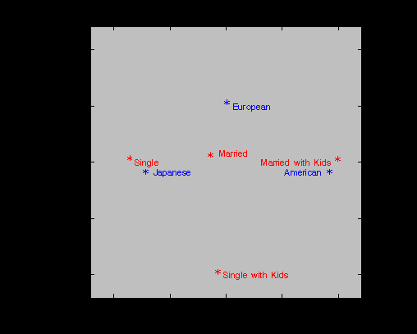
Cars by Marital Status

Slide 42
Canonical Discriminant Analysis
Predicts a discrete response from continuous predictor variables
Aims to determine which of g groups each respondent belongs to, based on the predictors
Finds the linear combination of the predictors with the highest correlation with group membership
Called the first canonical variate
Repeat to find further canonical variates that are uncorrelated with the previous ones
Produces maximum of g-1 canonical variates

Slide 43
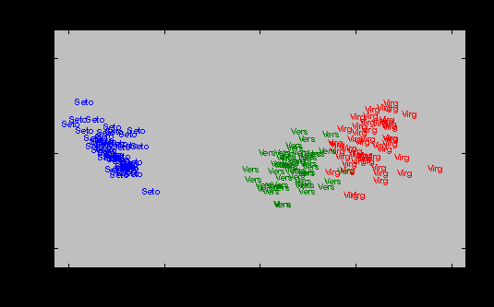
CDA Plot
Canonical Var 2
Canonical Var 1

Slide 44
Discriminant Analysis
Discriminant analysis also refers to a wider family of techniques
Still for discrete response, continuous predictors
Produces discriminant functions that classify observations into groups
These can be linear or quadratic functions
Can also be based on non-parametric techniques
Often train on one dataset, then test on another

Slide 45
CHAID
Chi-squared Automatic Interaction Detection
For discrete response and many discrete predictors
Common situation in market research
Produces a tree structure
Nodes get purer, more different from each other
Uses a chi-squared test statistic to determine best variable to split on at each node
Also tries various ways of merging categories, making a Bonferroni adjustment for multiple tests
Stops when no more “statistically significant” splits can be found

Slide 46
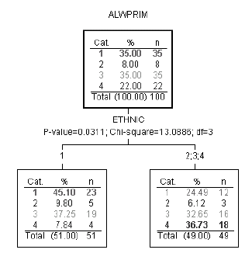
Example of CHAID Output

Slide 47
Titanic Survival Example
Adults (20%)
/
/
Men
/ \
/ \
/ Children (45%)
/
All passengers
\
\ 3rd class or crew (46%)
\ /
\ /
Women
\
\
1st or 2nd class passenger (93%)

Slide 48
CHAID Software
Available in SAS Enterprise Miner (if you have enough money)
Was provided as a free macro until SAS decided to market it as a data mining technique
TREEDISC.SAS – still available on the web, although apparently not on the SAS web site
Also implemented in at least one standalone package
Developed in 1970s
Other tree-based techniques available
Will discuss these later

Slide 49
TREEDISC Macro
%treedisc(data=survey2, depvar=bs,
nominal=c o p q x ae af ag ai: aj al am ao ap aw bf_1 bf_2 ck cn:,
ordinal=lifestag t u v w y ab ah ak,
ordfloat=ac ad an aq ar as av,
options=list noformat read,maxdepth=3,
trace=medium, draw=gr, leaf=50,
outtree=all);
Need to specify type of each variable
Nominal, Ordinal, Ordinal with a floating value

Slide 50
Partial Least Squares (PLS)
Multivariate generalisation of regression
Have model of form Y=XB+E
Also extract factors underlying the predictors
These are chosen to explain both the response variation and the variation among predictors
Results are often more powerful than principal components regression
PLS also refers to a more general technique for fitting general path models, not discussed here

Slide 51
Structural Equation Modeling (SEM)
General method for fitting and testing path analysis models, based on covariances
Also known as LISREL
Implemented in SAS in PROC CALIS
Fits specified causal structures (path models) that usually involve factors or latent variables
Confirmatory analysis

Slide 52
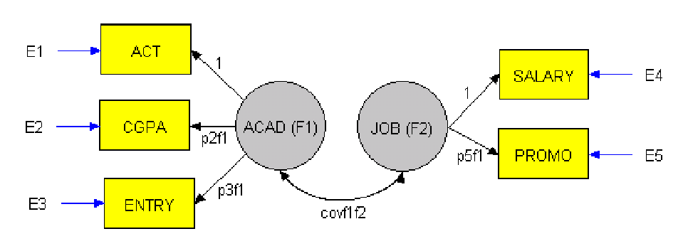
SEM Example: Relationship between Academic and Job Success

Slide 53
SAS Code
data jobfl (type=cov);
input _type_ $ _name_ $ act cgpa entry
salary promo;
cards;
n 500 500 500 500 500
cov act 1.024
cov cgpa 0.792 1.077
cov entry 0.567 0.537 0.852
cov salary 0.445 0.424 0.518 0.670
cov promo 0.434 0.389 0.475 0.545 0.716
;
proc calis data=jobfl cov stderr;
lineqs
act = 1*F1 + e1,
cgpa = p2f1*F1 + e2,
entry = p3f1*F1 + e3,
salary = 1*F2 + e4,
promo = p5f1*F2 + e5;
std
e1 = vare1,
e2 = vare2,
e3 = vare3,
e4 = vare4,
e5 = vare5,
F1 = varF1,
F2 = varF2;
cov
f1 f2 = covf1f2;
var act cgpa entry salary promo;
run;

Slide 54
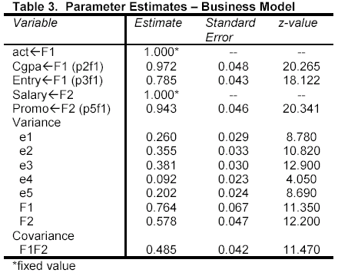
Results
All parameters are statistically significant, with a high correlation being found between the latent traits of academic and job success
However the overall chi-squared value for the model is 111.3, with 4 d.f., so the model does not fit the observed covariances perfectly

Slide 55
Latent Variable Models
Have seen that both latent trait and latent class models can be useful
Latent traits for factor analysis and SEM
Latent class for probabilistic segmentation
Mplus software can now fit combined latent trait and latent class models
Appears very powerful
Subsumes a wide range of multivariate analyses

Slide 56
Broader MVA Issues
Preliminaries
EDA is usually very worthwhile
Univariate summaries, e.g. histograms
Scatterplot matrix
Multivariate profiles, spider-web plots
Missing data
Establish amount (by variable, and overall) and pattern (across individuals)
Think about reasons for missing data
Treat missing data appropriately – e.g. impute, or build into model fitting

Slide 57
MVA Issues
Preliminaries (continued)
Check for outliers
Large values of Mahalonobis’ D²
Testing results
Some methods provide statistical tests
But others do not
Cross-validation gives a useful check on the results
Leave-1-out cross-validation
Split-sample training and test datasets
Sometimes 3 groups needed
For model building, training and testing

